Slide 1
Blockchain: From use case evaluation to Architectural and Development best practices — Varun Ojha IBM Software Lab - India

Slide 2
Agenda
Blockchain use case evaluation
Good Blockchain use case or bad?
What makes a good Blockchain use case
What makes a good first use case
Use case evaluation questions
Blockchain Architecture Best Practices
Sample Architecture
Integrating with existing systems
Key Architectural Decisions - Security
Blockchain Development Best Practices
Blockchain App Design
Chaincode best practices
Client side app best practices

Slide 3

Blockchain use cases
How to choose the right use case

Slide 4

Good blockchain use-case or bad?
Dispute Resolution
Holiday Tracking Tool
Know Your Customer
Land Records
Supply Chain
Track Your Child
Notes:
Let’s start with discussing what makes a good use case with this slide build. Some of these are obvious good blockchain use cases, others are obvious bad ones! What’s really important is the discussion, which we will summarize on the following two slides.
There are two separable questions (1) is it a good blockchain use case? (2) is it a good first project opportunity (since blockchain technology is still emerging / changing quickly) and new to most customers.
Here are a few thoughts on each bubble:
SECURE DOCUMENT STORE: Blockchain is a store of proof, not a document store. It is not generally suitable for large files; typically hashes are stored on-chain rather than the data itself.
FOOD PROVENANCE : a public reference and a good blockchain use case BUT a challenging first project due to organisational complexity and cross industry network
HOLIDAY TRACKING TOOL : why would you need blockchain for this? Better done with more mature technology.
TRACK YOUR CHILD : again, not an obvious blockchain use case – perhaps more of an IoT project? Also, who would we trust to run the network? Different views on this one.
KNOW YOUR CUSTOMER : excellent blockchain use case – but HARD! For a first project, we would need to find a “corner” of the problem (e.g. elimination of multiple registration at different bank branches) to make it realisable.
ELECTRONIC MEDICAL RECORDS – again, a great blockchain use case – but due to the complexities and sensitivities involved – and in view of the complexities of the business network, not such a good place to start.

Slide 5
What makes a good blockchain use case?
Identifying a good blockchain use-case is not always easy!
However there should always be:
A business problem to be solved
That cannot be more efficiently solved with other technologies
An identifiable business network
With Participants, Assets and Transactions
A need for trust
Consensus, Immutability, Finality or Provenance
Notes:
These are three, pragmatic tests that we can apply to assess the use case suitability for blockchain. Let’s look at each in a little more detail.
Point 1 is in two parts. The first may sound obvious, but the only way to really get to grip with blockchain for business is to focus on what challenges your users currently. Our most successful projects are sponsored by the users in an organization who are unhappy with how things are working today. Another way to put this is to avoid “technology experiments” . . .
The second part of point 1 is important because blockchain is new, and not yet a stable, mature technology – so if the problem can be solved with (for example) a distributed database, let’s do that! Another way to put this is to avoid “blockchain religion” . . .
The second point in *direct* terms is no business network = not a blockchain use case! As we covered at the start of Blockchain Explained, the business network will generate wealth by transference of assets between participants in the form of transactions. Trust is engendered through consensus, immutability, finality & provenance. The more important TRUST is to the use case, the more VALUE blockchain will add.
The third point is important.

Slide 6
What makes a good first blockchain use case?
First use-cases are even more difficult to identify!
A limited scope, but still solves a real business problem
Minimum Viable Product in a few weeks of effort
A smaller business network
Usually without requiring regulators and consortia
Allows for scaling with more participants and scenarios
Consider shadow chains to mitigate risks
Start small, succeed and grow fast!
Notes:
OK – this is an important, separate point arising from the relative immaturity of blockchain technologies, and the customer’s need increase their levels of awareness before embarking on anything too ambitious.
We can talk for ever with a customer about (e.g.) smart contracts, but they will not really understand the true power they start to apply them to their business.
So the essence is BE AGILE – start small (with a clear business focus) – show success (by stakeholder demonstration) – grow fast (through focused, agile development).
This is easier if we limit the business network to a few participants initially, then grow it over time by demonstrating the MVP to the other participants.

Slide 7
Sample questions to ask for the selected use case:
What is the specific business problem / challenge that the first project will address?
What is the current way of solving this business problem?
Assuming the business problem is large, what specific aspects of this business problem will be addressed?
Who are the business network participants (organizations) involved and what are their roles?
Who are the specific people within the organization and what are their job roles?
What assets are involved and what is the key information associated with the assets?
What are the transactions involved, between whom, and what assets are associated with transactions?
What are the main steps in the current workflow and how are these executed by the business network participants?
What is the expected benefit of applying blockchain technology to the business problem for each of the network participants?
What legacy systems are involved? What degree of integration with the legacy systems is needed?

Slide 8
Template – example only (Cross Border Supply Chain)
Problem
90% of goods in global trade are carried by the ocean shipping
industry each year. Costs associated with trade documentation
processing and administration are estimated to be up to 20%
the actual physical transportation costs.
Pain Points
Transport remains highly dependant on a flood of paper that is never digitised
Shipping information must pass through many hands, increasing potential for delays in transport.
One shipment can require sign-off from 30 unique organizations and up to 200 communications.
One lost form or late approval could leave the container stuck in port
The entire process can take more than one month..
Fraudulent changes may be made to the Bill of Lading
Solution
Manage and track the paper trail of tens of millions of shipping containers across the world by digitizing the supply chain process
Participants
Supplier, couriers (*2), customs (*2) , ports (*2), shipper and retailer ….
Asset & Trust
Need for trust around paperwork associated with a container
Transactions
Supplier prepares to ship, release container to courier, load to ship, clear customs, retailer receipt
Benefits benchmarks
- Value Tree
Baseline
Phase 1
Phase 2-3
F
M
M
M
Blockchain : Design Points
References
KPI’s (e.g.)
F
F
M
M
M
New
revenue
# new value propositions
-
-
1 to 3
Find new value propositions to exploit the network effect between members
Increase in customer satisfaction
-
5%
10%
Securely and transparently trace the container’s path through the supply chain on the blockchain
Add trust (Immutability and Provenance) around the Bill of Lading and other container paperwork
Automate the transit and shipping process with Smart Contracts reducing cycle times and delays
No reconciliation or matching of documentation with near instant updates - eliminates the need for audit and verification
Removes paper and intermediaries
Improve
client
experience
Increase in trade volumes
-
+5%
+15%
Cycle times (transit & shipping)
30 days
25 days
10 days
ANO -1
Reduce
transport
costs
Waste as % of total shipped
6%
5%
1%
ANO -2
Fraud and errors as % of total costs
5%
4%
0.5%
Documentation admin. as % of total costs
20%
15%
5%
Notes:
One example chart from a Business Value Assessment. Notice that the problem contains definitions of the participants, assets and transactions that are pertinent to the use-case.
Notice as well the benefits benchmarks. Baseline is the as-is scenario, Phase 1 is the minimum viable ecosystem and Phase 2 is the mature blockchain network.

Slide 9
Blockchain Architecture
End to end application architecture with Blockchain

Slide 10
High Level Architecture

Slide 11
Integrating with Existing Systems – Possibilities
2. Blockchain events
1. System events
!
!
Existing systems
Call into blockchain network from existing systems
Transform
Blockchain network
Call out to existing systems
Existing systems
Notes:
Events are crucial in integrating with existing systems as they allow you to trigger behaviour, either when something happens in the blockchain (e.g. update a UI when a transaction is confirmed), or when something happens in an external system (e.g. a system clock tells us ten minutes has passed).
Of course, instead of triggering this behaviour through events, you can also (3) instantiate blockchain transactions directly from existing systems, or (4) external actions directly from the blockchain.

Slide 12
Key Architectural Decisions – Security
Ensuring privacy of transactions and data exchanged in a Blockchain
Ledgers exist within the scope of a channel
Transaction data and smart contract isolation
A single global channel
Share common data such as reference data among all participants
Data privacy compromised
Bilateral and Multi lateral channels
Data privacy rules can be satisfied
Too many channels can lead to operational and management complexity
Private Data Collections
Transaction and Data privacy within participants of a channel
Ordering service has only evidence of transactions

Slide 13
Blockchain Development
Best practices for application development

Slide 14
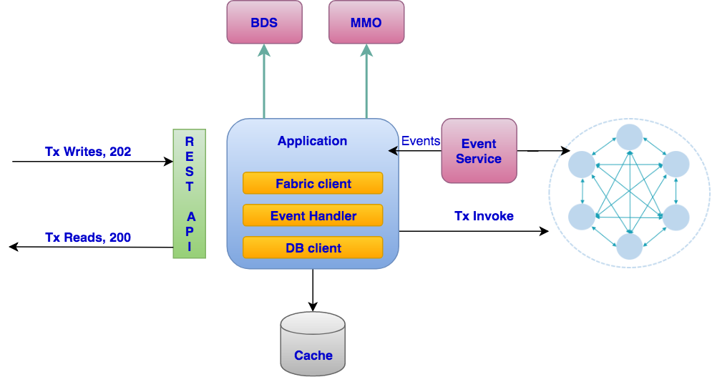
Blockchain Application Design

Slide 15
Programming Best Practices - Chaincode
Non Deterministic chaincode
random(), getDateTime()
Avoid collection updates to prevent MVCC errors
Inserts vs updates
Consider data immutability
Chaincode to Chaincode calls
Attribute based access control
Extract caller information from certificate
Roles and attributes from certificate
On chain vs Off chain storage
PDF, images etc off chain and hash on chain
Notes:
Be aware that systems integration in blockchain is DIFFICULT to get right because of its distributed nature. Individual transactions are run multiple on multiple nodes and as we’ll see in the next section, the network needs to agree on the result in order for consensus to be achieved.
Therefore, you can’t do things like random numbers as each invocation will probably return a different result, and consensus will not be achieved. Even things like timestamps, exchange rates, temperature readings and mileage of a moving car will be susceptible to minor variances, so cannot be relied on.
The problem gets worse when calling out to external systems, because it is easy to get into a situation where the external system is called multiple times, with potentially different values. Think about a simple example of incrementing a value in an external system. The result will be dependent on how many nodes there are in the blockchain network, as each invocation of the smart contract will cause the value to be incremented.
To get round this problem, you need to detect duplicate invocations either in the blockchain, middleware or external system – or otherwise guarantee consistency for a given transaction
Read up on the concepts of ‘oracles’ or ’cryptlets’ for more details on these.

Slide 16
Programming Best Practices – Client App
Asychronous API
Transactions API, webhooks or push events
Event microservice
Transaction vs Block listeners
Client side data caching
Faster reads
Better querying capabilities
Client side load balancing and HA
Load balance between different peers of an org
Detect peer downtime and switch to HA peer

Slide 17
Thank you.
Varun Ojha
Lead Architect, Tradelens
IBM India Software Lab
—
Varun.ojha@in.ibm.com
ibm.com

